Slide 1
Dayananda Sagar University
School of Engineering
Devarakaggalahalli, Harohalli Kanakapura Road, Dt, Ramanagara, Karnataka 562112
Department of Computer Science & Engineering
(Artificial Intelligence & Machine Learning)
FULL STACK DEVELOPMENT
SEMESTER – IV
Unit-1

Slide 2
Syllabus
UNIT – I
Introduction to HTML: HTML syntax HTML elements HTML document structure CSS selectors properties, and values Build your first web page Semantics of HTML Block and inline elements Hyperlinks, Lists, Tables, Forms Create a basic multi page website Cascading effect Advanced selectors CSS resets Positioning.

Slide 3
WHAT IS HTML
HTML - HyperText Markup Language
It is the standard language used to create and design webpages.
It provides the structure of a webpage by using elements like headings, paragraphs, images, links, and tables .
HTML works alongside CSS (Cascading Style Sheets) for styling and JavaScript for interactivity.

Slide 4
HTML syntax
<!DOCTYPE html>
<html>
<head>
<title>My First Webpage</title>
</head>
<body>
<h1>Welcome to My Website</h1>
<p>This is a simple webpage using HTML.</p>
<a href="https://www.example.com">Click here</a> to visit an example site.
</body>
</html>
Where,
<html>: The root element of an HTML document.
<head>: Contains metadata like the title and links to stylesheets.
<title>: Defines the title of the webpage (shown on the browser tab).
<body>: Contains the content of the webpage (text, images, links, etc.)
.<h1> to <h6>: Headings, where <h1> is the largest and <h6> is the smallest.
<p>: Paragraphs for text content.
<a>: Anchor tag for hyperlinks.
<img>: Displays images
.<table>, <div>, <span>, <form>, etc.:Used for layout and forms.

Slide 5
HTML elements
An HTML element is defined by a start tag, some content, and an end tag.
Syntax: <tagname>Content goes here...</tagname>
Examples of some HTML elements:
<h1>My First Heading</h1>
<p>My first paragraph.</p>
HTML elements can be nested (this means that elements can contain other elements).
Empty HTML Elements (no content)
Example <p>This is a <br> paragraph with a line break.</p>

Slide 6
HTML document structure
An HTML document follows a standard structure that defines the layout and elements of a webpage.
<!DOCTYPE html>
<html lang="en">
<head>
<meta charset="UTF-8">
<meta name="viewport" content="width=device-width, initial-scale=1.0">
<title>Simple Webpage</title>
</head>
<body>
<h1>Welcome to My Website</h1>
<p>This is a simple webpage created using HTML.</p>
<a href="https://www.example.com">Visit Example</a>
<h2>My Favorite Fruits</h2>
<ul>
<li>Apple</li>
<li>Banana</li>
<li>Orange</li>
</ul>
<p>&copy; 2025 My Website</p>
</body>
</html>

Slide 7
CSS selectors and advanced
A CSS selector selects the HTML element(s) we want to style.
CSS selectors are used to "find" (or select) the HTML elements we want to style. We can divide CSS selectors into five categories:
Simple selectors (select elements based on name, id, class)
Combinator selectors (select elements based on a specific relationship between them)
Pseudo-class selectors (select elements based on a certain state)
Pseudo-elements selectors (select and style a part of an element)
Attribute selectors (select elements based on an attribute or attribute value)

Slide 8
CSS selectors continued
The CSS element Selector-The element selector selects HTML elements based on the element name.
Example: Here, all <p> elements on the page will be center-aligned, with a red text color:
p { text-align: center; color: red; }
The CSS id Selector-The id selector uses the id attribute of an HTML element to select a specific element.
Example:The CSS rule below will be applied to the HTML element with id="para1":
#para1 { text-align: center; color: red; }

Slide 9
CSS selectors continued
The CSS Class Selector-The class selector styles multiple elements with the same class name.
Example: In this example all HTML elements with class="center" will be red and center-aligned:
.center { text-align: center; color: red; }
The CSS Universal Selector-The universal selector (*) selects all HTML elements on the page.
* { text-align: center; color: blue; }

Slide 10
CSS selectors continued
The CSS Grouping Selector-Instead of writing separate rules, we can group multiple elements.
h1 { text-align: center; color: red; } h2 { text-align: center; color: red; } p { text-align: center; color: red; }
OR
h1, h2, p { text-align: center; color: red; }
All <h1>,<h2>, and <p> elements will have the same styles

Slide 11
Example of applying different CSS styling
<!DOCTYPE html>
<html lang="en">
<head>
<meta charset="UTF-8">
<meta name="viewport" content="width=device-width, initial-scale=1.0">
<title>CSS Selectors Example</title>
<style>
/* Element Selector */
p { text-align: center; color: red;
}
/* ID Selector */
#para1 {
font-size: 20px;
font-weight: bold;
}

Slide 12
Example of applying different CSS styling
/* Class Selector */
.center {
text-align: center;
color: red;
}
/* Universal Selector */
* { font-family: Arial, sans-serif;
}
/* Grouping Selector */
h1, h2, p {
text-align: center;
color: red;
}

Slide 13
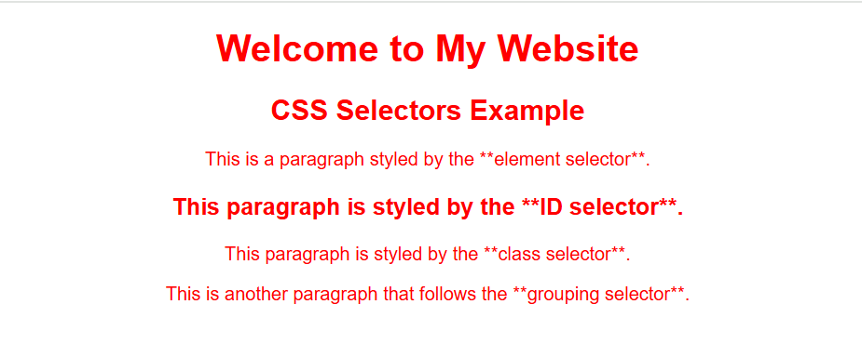
Example of applying different CSS styling
</style>
</head>
<body>
<h1>Welcome to My Website</h1>
<h2>CSS Selectors Example</h2>
<p>This is a paragraph styled by the **element selector**.</p>
<p id="para1">This paragraph is styled by the **ID selector**.</p>
<p class="center">This paragraph is styled by the **class selector**.</p>
<p>This is another paragraph that follows the **grouping selector**.</p>
</body>
</html>

Slide 14
HTML Properties and Values
In HTML, properties (often called attributes) provide additional information about elements. They are written inside the opening tag of an element and have corresponding values.
Attribute (Property) | Description | Example
id | Unique identifier for an element | <div id="header">
class | Assigns one or more classes for styling | <p class="intro">
style | Inline CSS styles | <h1 style="color: blue;">
title | Tooltip text on hover | <abbr title="HyperText Markup Language">HTML</abbr>
href | URL link for <a> elements | <a href="https://example.com">Visit</a>
src | Image or media source | <img src="image.jpg">
alt | Alternative text for images | <img src="logo.png" alt="Website Logo">
width & height | Image or iframe size | <img src="photo.jpg" width="300" height="200">

Slide 15
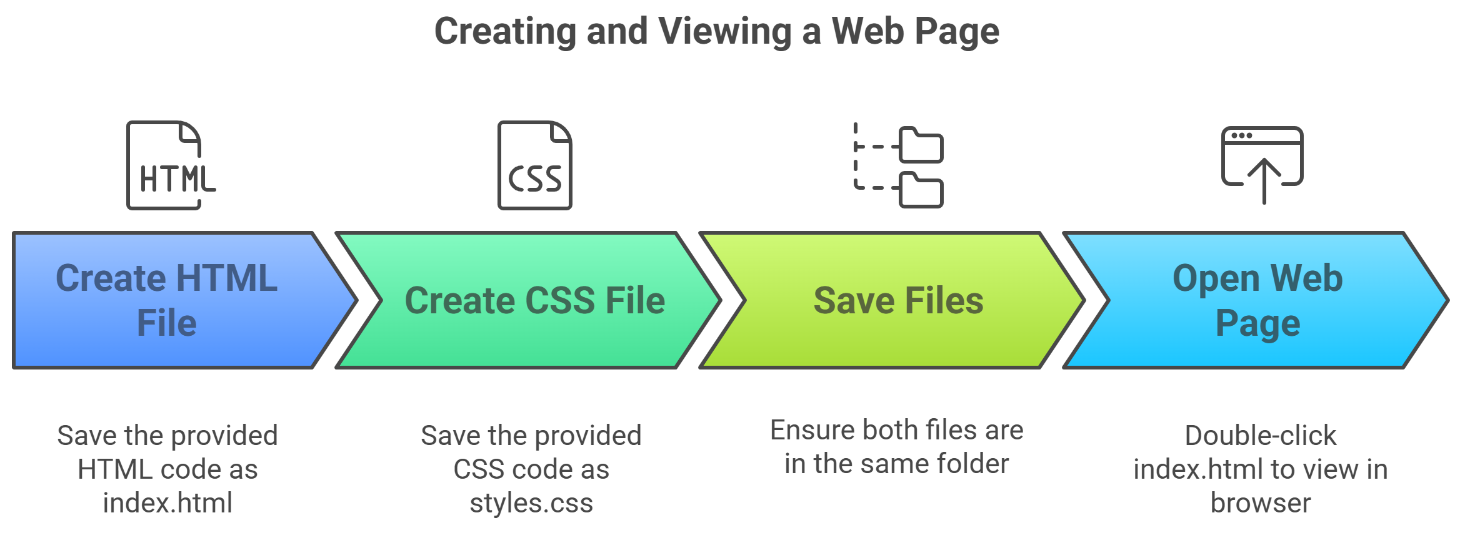
Build your first web page

Slide 16
Build your first web page
Create the HTML File:Save the following code as index.html
<!DOCTYPE html>
<html lang="en">
<head>
<meta charset="UTF-8">
<meta name="viewport" content="width=device-width, initial-scale=1.0"> <title>My First Web Page</title>
<link rel="stylesheet" href="styles.css">
</head>
<body>
<header>
<h1>Welcome to My Website</h1>
</header>

Slide 17
Build your first web page continued
<nav>
<ul>
<li><a href="#">Home</a>
</li> <li><a href="#">About</a></li>
<li><a href="#">Contact</a></li>
</ul>
</nav>
<section>
<h2>About Me
</h2> <p>This is my first web page, and I am excited to learn HTML!</p>
</section>
<footer>
<p>&copy; 2025 My Website. All rights reserved.</p>
</footer>
</body>
</html>

Slide 18
Build your first web page continued
Create the CSS File:Save the following as styles.css in the same folder
body {
font-family: Arial, sans-serif;
margin: 0;
padding: 0;
text-align: center;
background-color: #f4f4f4;
}
header {
background: #333;
color: white;
padding: 20px;}
nav ul {
list-style: none;
padding: 0;
}

Slide 19
Build your first web page continued
nav ul li {
display: inline;
margin: 10px;
}
nav ul li a {
text-decoration: none;
color: #333;
font-weight: bold;
}
section {
margin: 20px;
padding: 20px;
background: white;
border-radius: 5px;
box-shadow: 0 0 10px rgba(0, 0, 0, 0.1);
}
footer {
background: #333;
color: white;
padding: 10px;
position: absolute;
width: 100%;
bottom: 0;
}
Open Your Web Page
Double-click index.html to open it in a web browser

Slide 20
Semantics of HTML
A semantic element clearly describes its meaning to both the browser and the developer. This improves accessibility, readability, and search engine optimization (SEO).
Examples of non-semantic elements: <div> =division and <span>=span of text - Tells nothing about its content. Instead, they are generic containers used for styling and layout purposes.

Slide 21
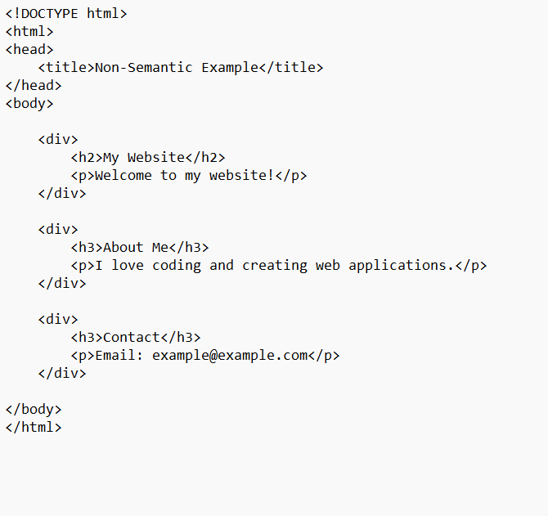
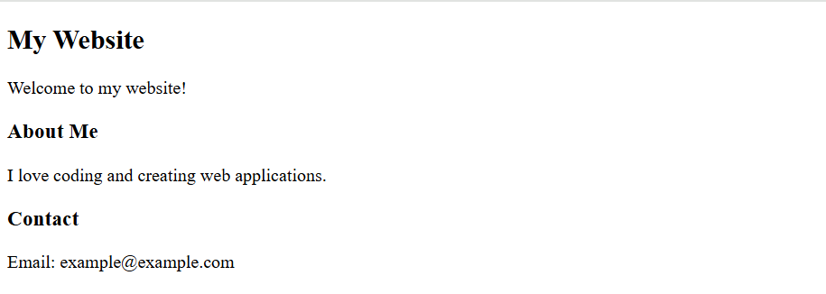
Semantics of HTML

Slide 22
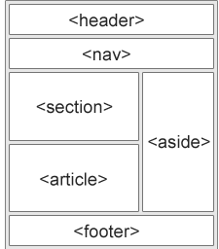
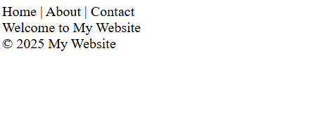
Semantics of HTML
Examples of semantic elements: <form>, <table>, and <article> - Clearly defines its content
Semantic Elements in HTML
Many web sites contain HTML code like:
<div id="nav">Home | About | Contact</div>
<div class="header">Welcome to My Website</div>
<div id="footer">© 2025 My Website</div>

Slide 23
Semantics of HTML continued
The <section> element defines a section in a document. Examples- Chapters, Introduction, News items, Contact information
The <article> element specifies independent, self-contained content. Examples- Forum posts, Blog posts, User comments, Product cards, Newspaper articles
The <header> element represents a container for introductory content or a set of navigational links. Examples-one or more heading elements (<h1> - <h6>),logo or icon,authorship information
The <footer> element defines a footer for a document or section. Examples-authorship information, copyright information, contact information, sitemap
The <nav> element defines a set of navigation links.
The <aside> element defines some content aside from the content it is placed in (like a sidebar).

Slide 24
Block and inline elements
Every HTML element has a default display value, depending on what type of element it is. The two most common display values are block and inline.
Block-level Elements:
A block-level element always starts on a new line, and the browsers automatically add some space (a margin) before and after the element.
A block-level element always takes up the full width available (stretches out to the left and right as far as it can).
Two commonly used block elements are: <p> and <div>.
The <p> element defines a paragraph in an HTML document.
The <div> element defines a division or a section in an HTML document.
Example:<p>Hello World</p> <div>Hello World</div>

Slide 25
Block and inline elements
Inline Elements
An inline element does not start on a new line.
An inline element only takes up as much width as necessary.
Example:<p>This is <span style="color:red;">inline</span> text.</p>
The word "inline" is colored red but stays within the same line as the rest of the sentence.

Slide 26
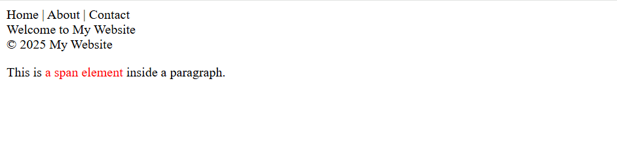
Block and inline elements
<nav>Home | About | Contact</nav>
<header>Welcome to My Website</header>
<footer>© 2025 My Website</footer>
<p>This is <span style="color: red;">a span
element</span> inside a paragraph.</p>

Slide 27
Hyperlinks
Hyperlinks (<a> tag) are used to link pages, external websites, sections within a
page, emails, and more.
Basic Hyperlink Syntax
<a href="https://www.google.com">Visit Google</a>
href → Specifies the URL. Clicking on "Visit Google" will open Google.
Link to Another Page in the Same Website syntax
<a href="about.html">About Us</a>
Links to about.html (another page in the same directory).

Slide 28
Hyperlinks
<!DOCTYPE html>
<html lang="en">
<head>
<meta charset="UTF-8">
<title>Hyperlink Examples</title>
</head>
<body>
<h1>Hyperlink Examples</h1> <p><a href="https://www.google.com" target="_blank">Open Google in a new tab</a></p>
</body>
</html>

Slide 29
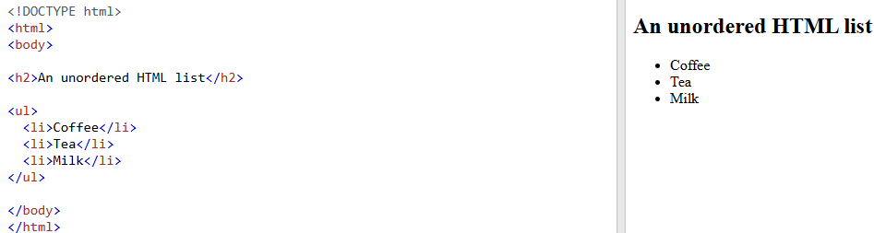
Lists
HTML lists allow web developers to group a set of related items in lists:Ordered and unordered lists.
Unordered HTML List-An unordered list starts with the <ul> tag. Each list item starts with the <li> tag.

Slide 30
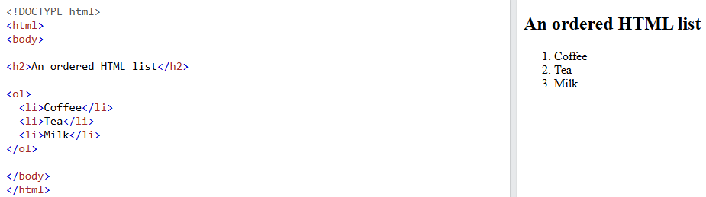
Lists continued
Ordered HTML List-An ordered list starts with the <ol> tag. Each list item starts with the <li> tag

Slide 31
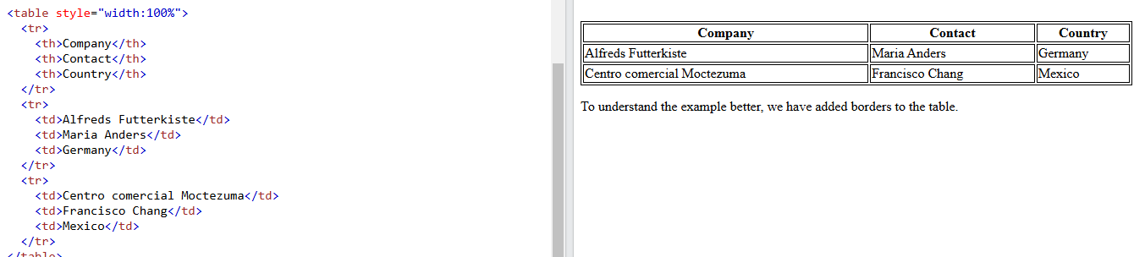
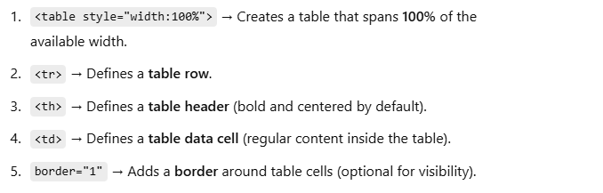
Tables
HTML tables allow web developers to arrange data into rows and columns-A ta
ble in HTML consists of table cells inside rows and columns.

Slide 32
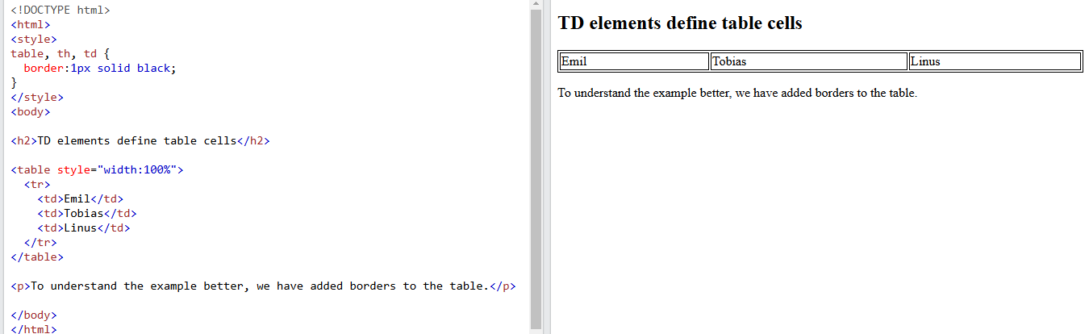
Tables continued
Table Cells-Each table cell is defined by a <td> and a </td> tag.
td stands for table data. Everything between <td> and </td> are the content of the table cell.

Slide 33
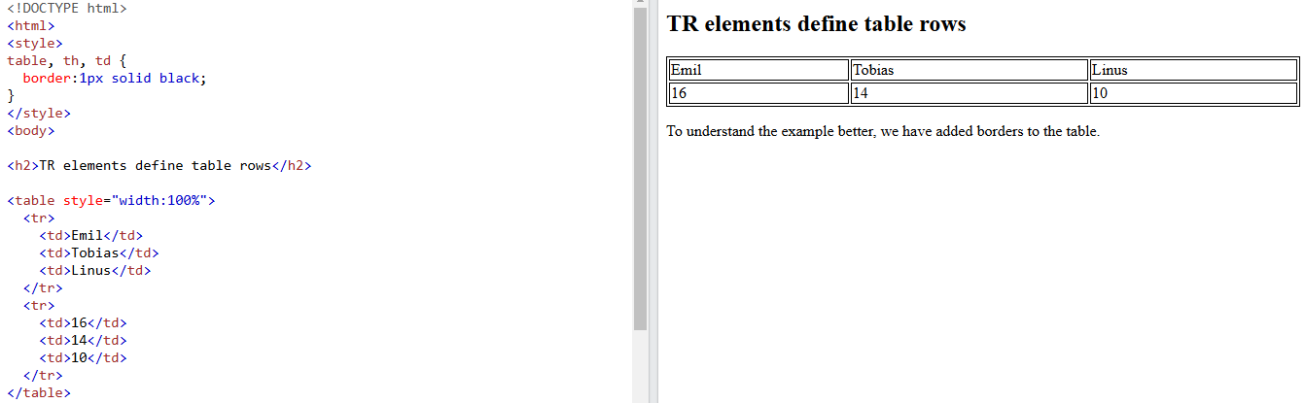
Tables continued
Table Rows-Each table row starts with a <tr> and ends with a </tr> tag. tr stands for table row.

Slide 34
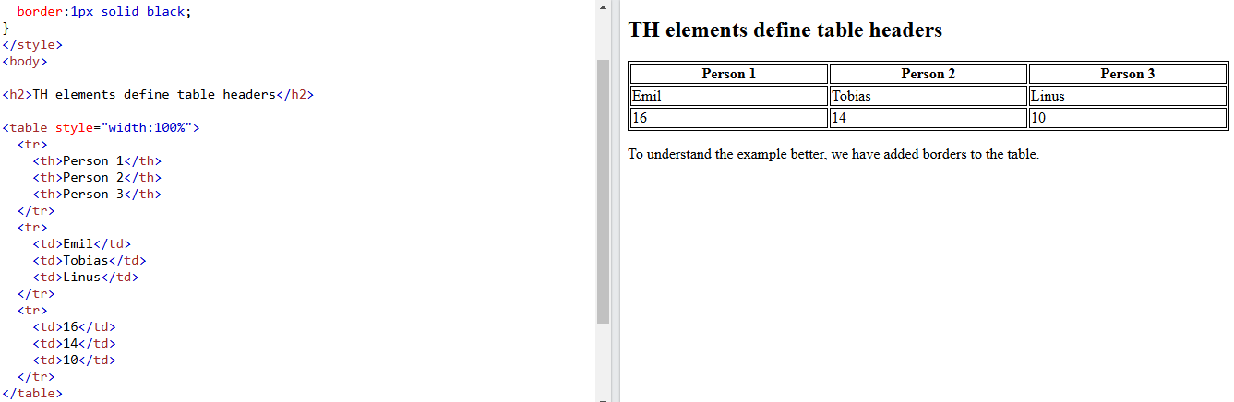
Tables continued
Table Headers- To make the cells to be table header cells. In those cases use the <th> tag instead of the <td> tag. th stands for table header.

Slide 35
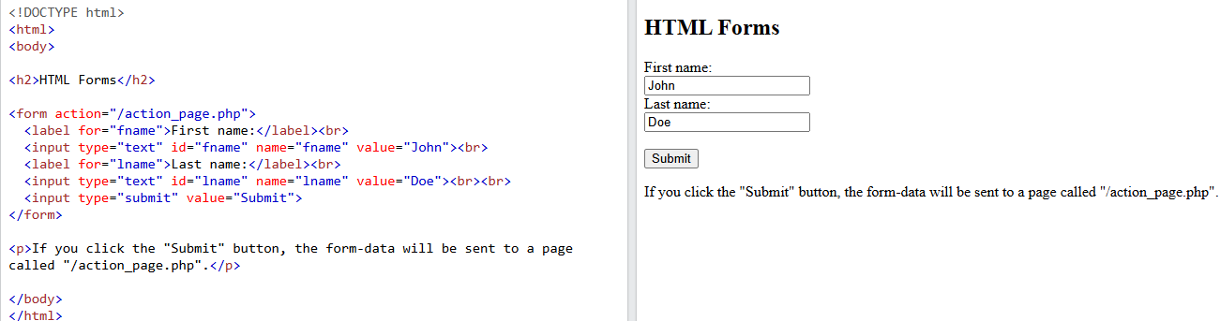
Forms
An HTML form is used to collect user input. The user input is most often sent to a server for processing.

Slide 36
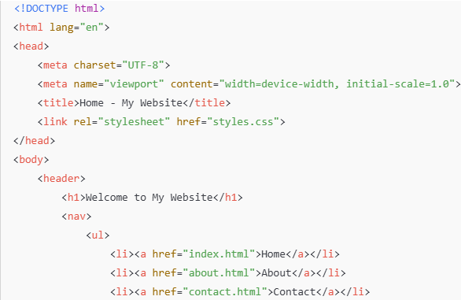
Creating a Basic Multi-Page Website
Example: ✅ Home Page ✅ About Page ✅ Contact Page ✅ Navigation Menu
Home Page (index.html)

Slide 37
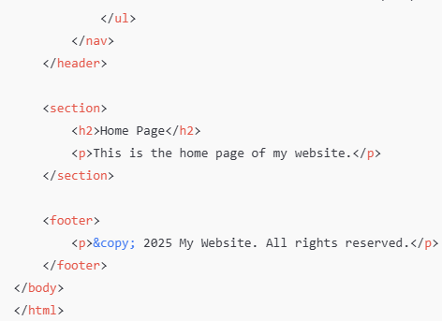
Creating a Basic Multi-Page Website

Slide 38
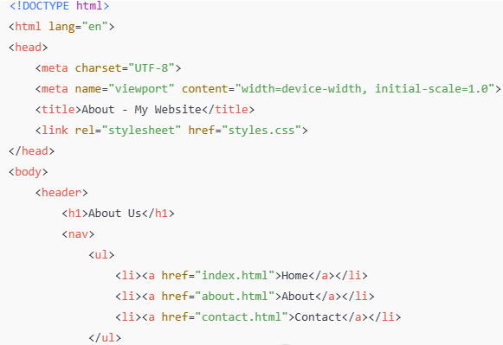
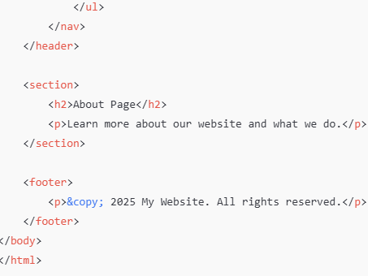
Creating a Basic Multi-Page Website
About Page (about.html)

Slide 39
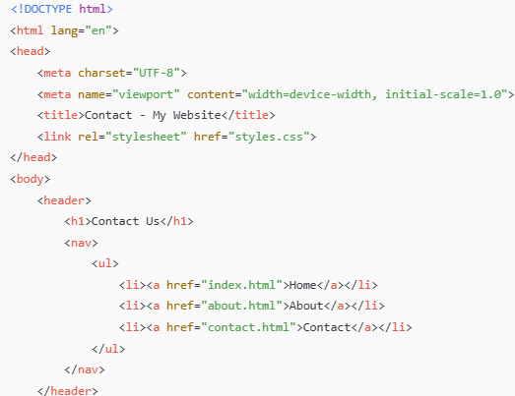
Creating a Basic Multi-Page Website
Contact Page (contact.html)

Slide 40
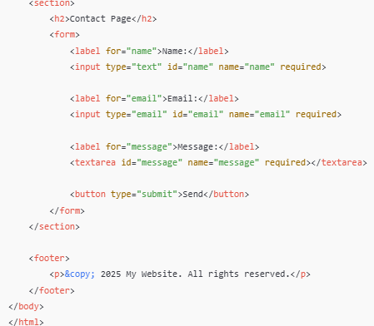
Creating a Basic Multi-Page Website

Slide 41
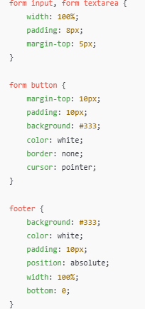
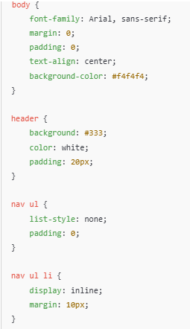
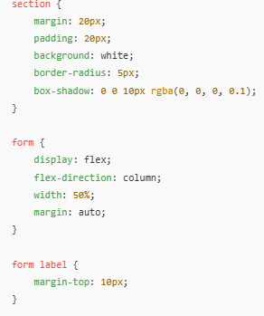
Creating a Basic Multi-Page Website
CSS File (styles.css)

Slide 42
TASK-Creating a Basic Multi-Page Website
Running the Website
Save all the files in a folder(Home.html,About.html,Contact.html,stles.css)
Open index.html in a web browser.
Click the navigation links to switch between pages.

Slide 43
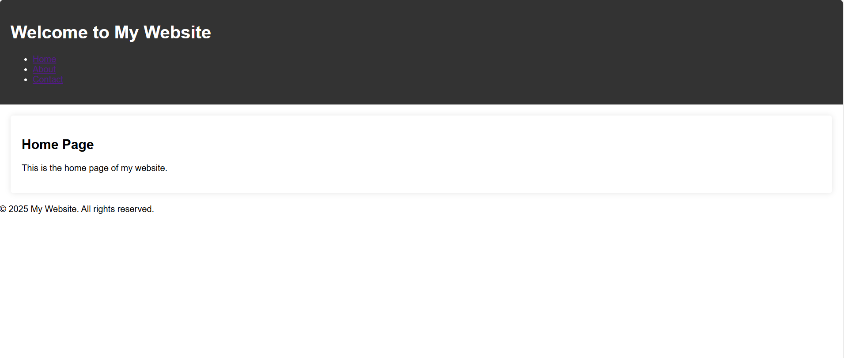
Task OUTPUT

Slide 44
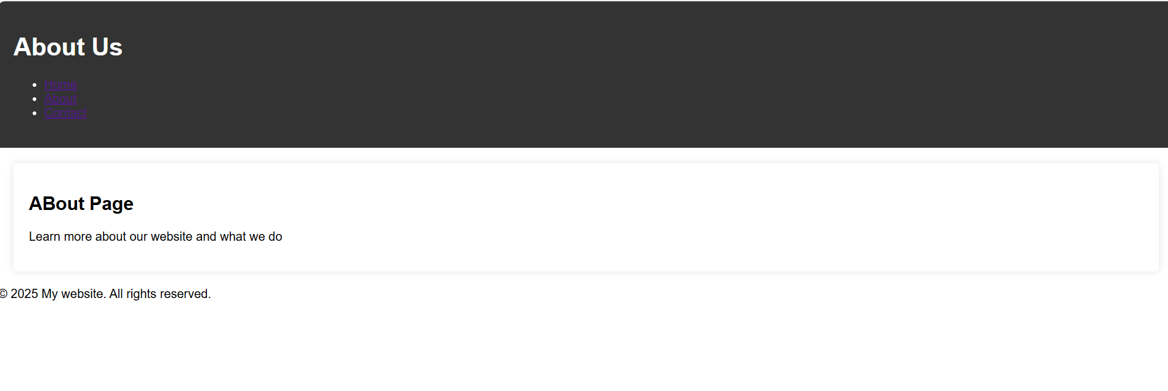
Task to create multi-Page website

Slide 45
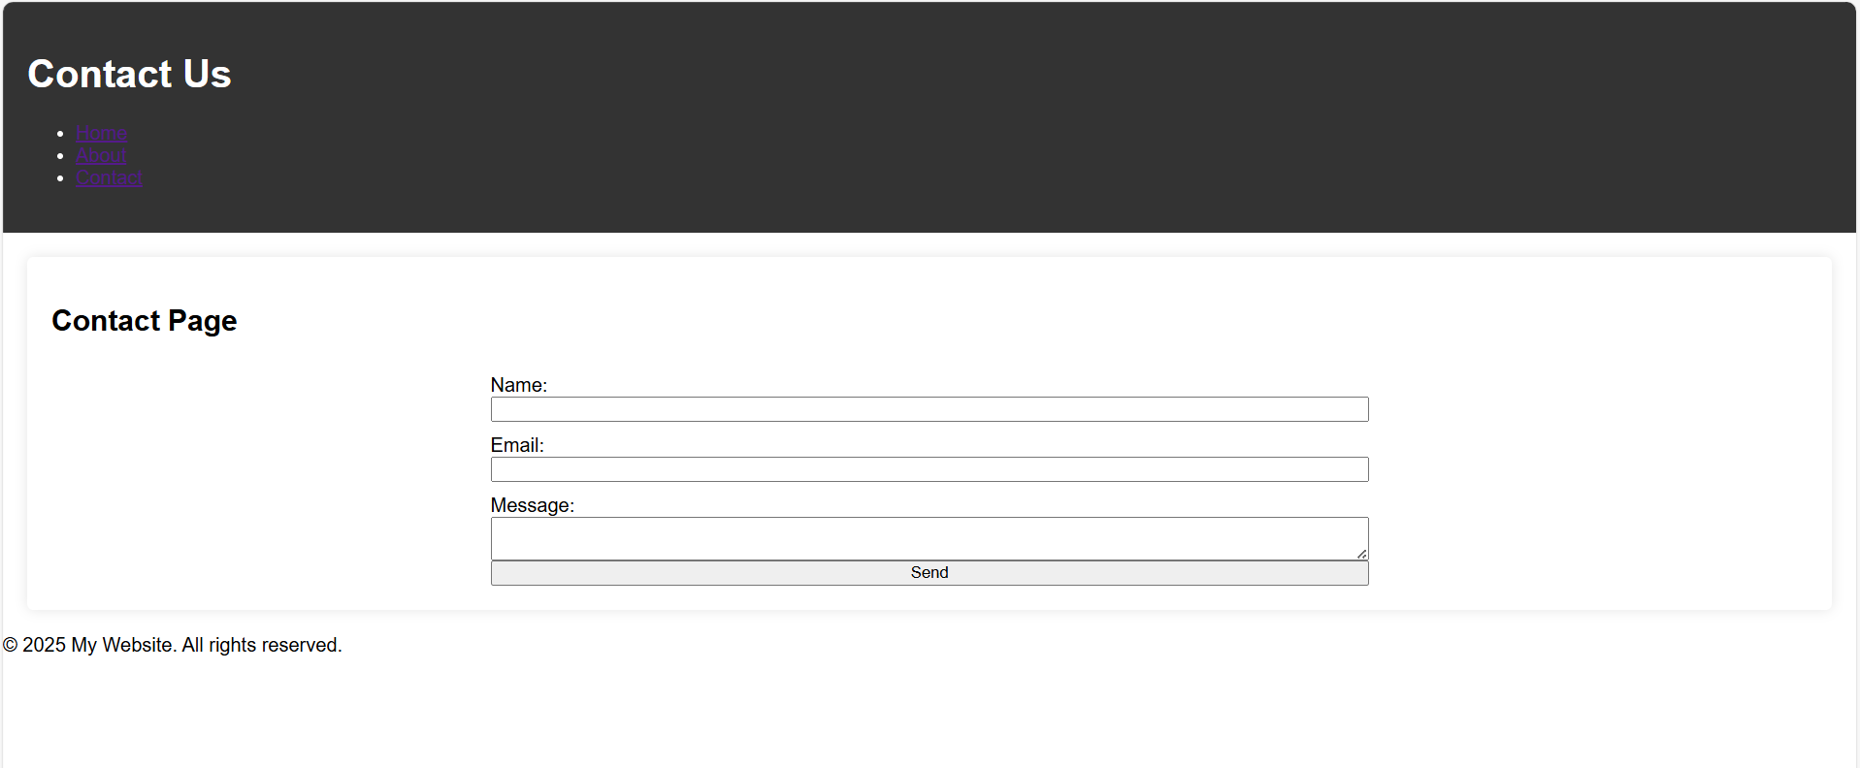
Task to create multi-Page website

Slide 46
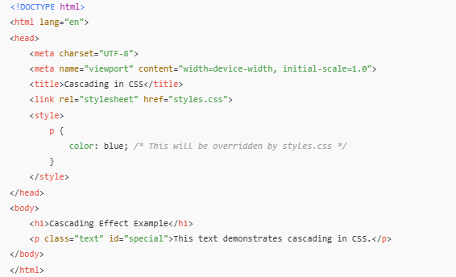
Cascading effect
Cascading in HTML -The term "Cascading" in Cascading Style Sheets (CSS) refers to how styles are applied to elements based on priority rules

Slide 47
CSS Resets
CSS resets are used to remove default browser styling (like margins, paddings, font sizes, and heading styles) to create a consistent baseline across different browsers. Each browser applies default styles differently, which can cause inconsistencies in the web design.
Basic CSS Reset: For a quick reset (small projects).
{
margin: 0;
padding: 0;
box-sizing:
border-box;
}
where, margin: 0; padding: 0; → removes default spacing.
box-sizing: border-box; → makes width calculations easier.

Slide 48
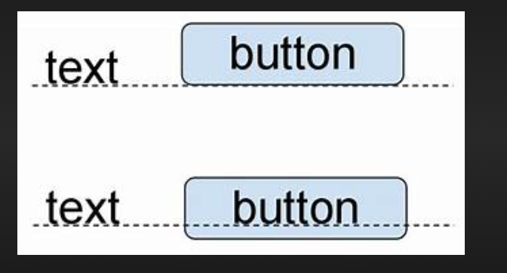
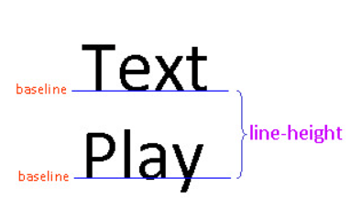
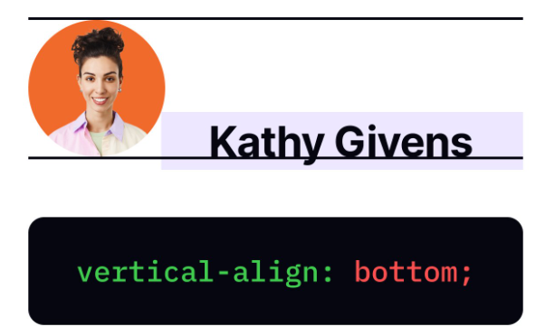
CSS Resets
Eric Meyer’s CSS Reset: Resets almost all elements, Removes list bullets, table spacing, and border styling, Normalizes font and vertical alignment.
html, body, div, span, applet, object, iframe, h1, h2, h3, h4, h5, h6, p, blockquote, pre, a, abbr, acronym, address, big, cite, code, del, dfn, em, img, ins, kbd, q, s, samp, small, strike, strong, sub, sup, tt, var, b, u, i, center, dl, dt, dd, ol, ul, li, fieldset, form, label, legend, table, caption, tbody, tfoot, thead, tr, th, td, article, aside, canvas, details, embed, figure, figcaption, footer, header, hgroup, menu, nav, output, ruby, section, summary, time, mark, audio, video{
margin: 0;
padding: 0;
border: 0;
font-size: 100%;
font: inherit;
vertical-align: baseline;
}
/* Set default styles */
body {
line-height: 1;
}
ol, ul {
list-style: none;
}table {
border-collapse: collapse;
border-spacing: 0;
}

Slide 49
CSS Resets
A Custom Modern Reset: For a minimal but effective reset. Keeps a clean layout while maintaining readability. Useful for modern web designs.
{
margin: 0;
padding: 0;
box-sizing: border-box;
}
body
{ font-family:
Arial, sans-serif;
line-height: 1.6;
color: #333;
background-color: #f8f9fa;
}
A
{ text-decoration:
none;
}
ul, ol
{
list-style: none;
}

Slide 50
Positioning
CSS positioning helps in setting the element/object on a desired location of your choice.
In Addition to it, we can add different values with it to make it more reliable and attractive.
There are five main position values:
Static (default)
Relative
Absolute
Fixed
Sticky

Slide 51
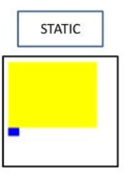
Positioning
Static Position (Default)
Default Positioning: Every element in HTML has
a default position of static unless specified otherwise.
Flow of the Document: Elements with position: static; are positioned according to the normal document flow.
They follow the order they appear in the HTML.
No Offset Properties: When an element is set to static, the properties top, right, bottom, and left do not apply. Any values set for these properties will be ignored.
div {
position: static;
}

Slide 52
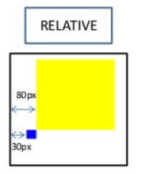
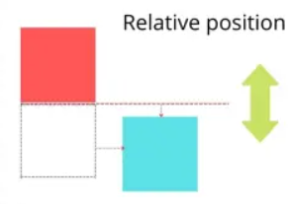
Positioning continued
Relative Position-An element is positioned relative to its original position.
Can move top, left, right, bottom , while still maintaining its allocated space in the document flow
.box {
position: relative;
left: 50px; /* Moves right by 50px */
top: 20px; /* Moves down by 20px */
}

Slide 53
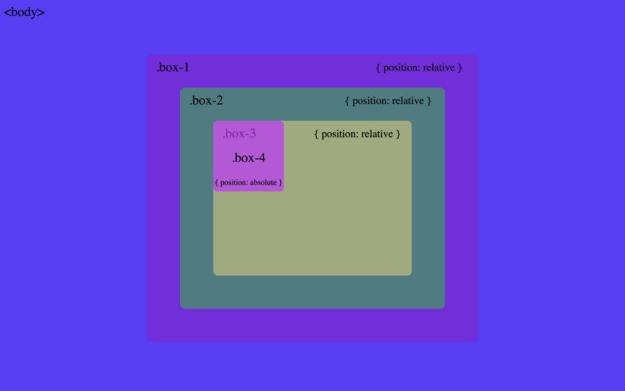
Positioning continued
Absolute Position-
It means the element is removed from the normal flow of the page and placed exactly where you want it, using top, left, right, or bottom.
It is positioned relative to the nearest positioned ancestor (an element with position: relative; absolute;fixed; or sticky;).
If no positioned ancestor exists, it will be placed relative to the entire page (<html> or <body>).
Can be placed anywhere inside a parent container.

Slide 54
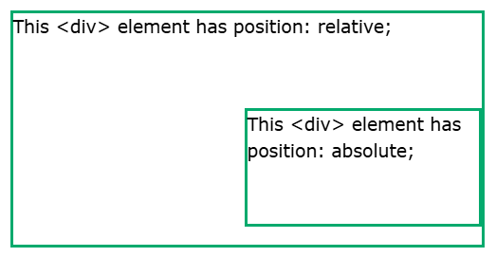
Positioning continued
div.relative { position: relative; width: 400px; height: 200px; border: 3px solid #73AD21; } div.absolute { position: absolute; top: 80px; right: 0; width: 200px; height: 100px; border: 3px solid #73AD21; }

Slide 55
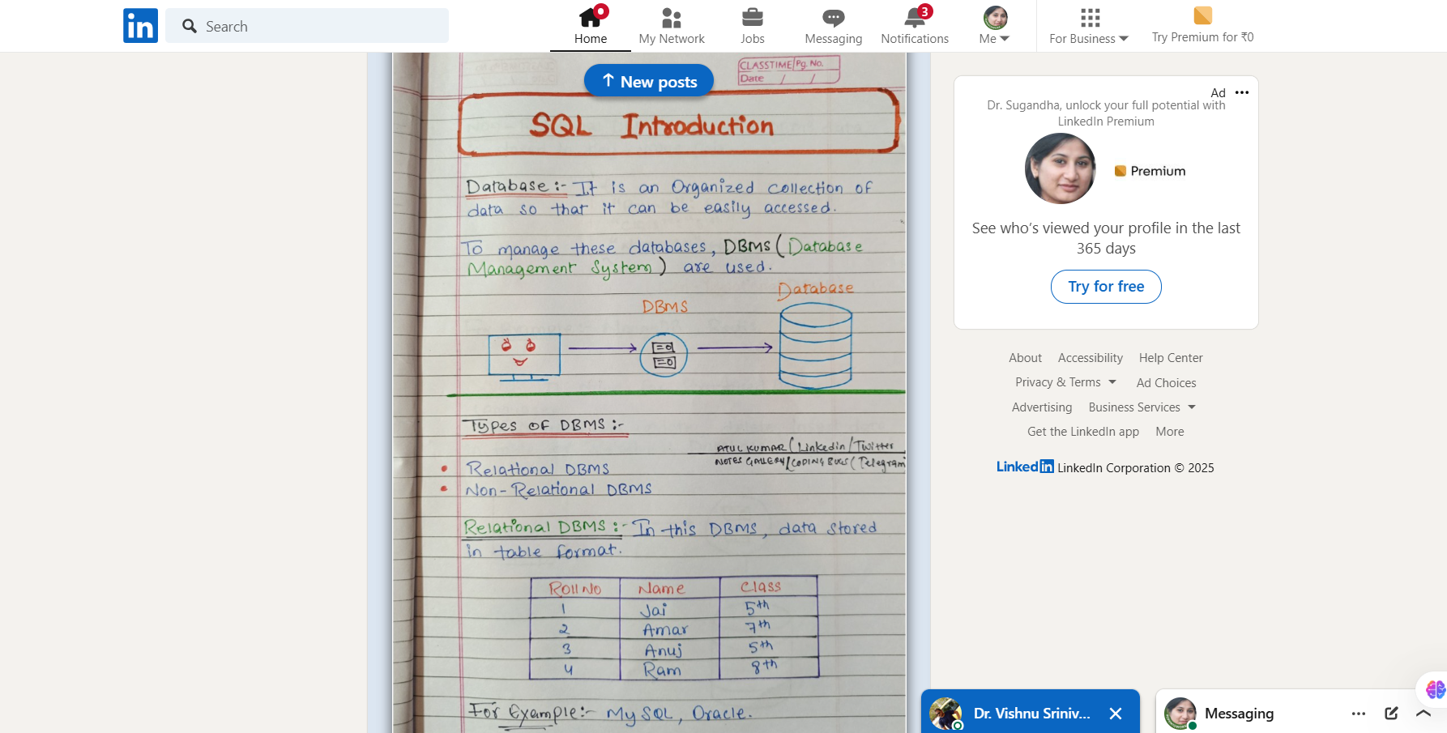
Positioning continued
Fixed Position-staying fixed even when scrolling. Always stays in the same place.Useful for navigation bars, floating buttons, etc.
.fixed-nav {
position: fixed;
top: 0;
width: 100%;
background: black;
color: white;
padding: 10px;
}

Slide 56
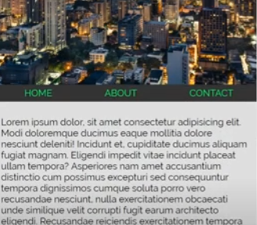
Positioning continued
Sticky Position-An element acts like relative until scrolling reaches a certain point, then sticks like fixed. Great for sticky headers or sidebars. Only works if parent has enough height.
.sticky-header {
position: sticky;
top: 0;
background: yellow;
padding: 10px;
}

Slide 57
TASK
You have been assigned to design a simple webpage for a local bakery called "Sweet Treats." The webpage should include the following:
A title header displaying the bakery name "Sweet Treats" at the top of the page.
A short introduction about the bakery with a paragraph describing the specialties.
A list of three popular bakery items with prices.
An image of the bakery or its products (you can use a placeholder image).
A footer with the text "Visit Us Today!" and the bakery's location.
The webpage should be designed using basic HTML tags like headings, paragraphs, lists, images, and a footer. Apply simple CSS for styling the page to make it visually appealing.
Requirements:
The page should have a clean layout with a pleasant background color.
The title should be large and centered.
The introduction text should be smaller and aligned to the left.
The list of bakery items should have a neat design with item names and prices.
The footer text should be centered at the bottom of the page.

Slide 58
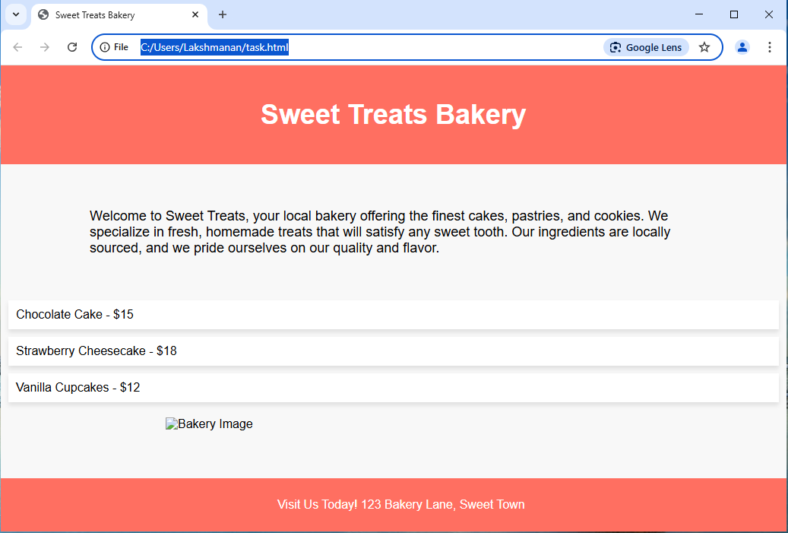
TASK OUTPUT

